Slide 1

Merme Generator 3000
by Nicolas Di Costanzo

Slide 2
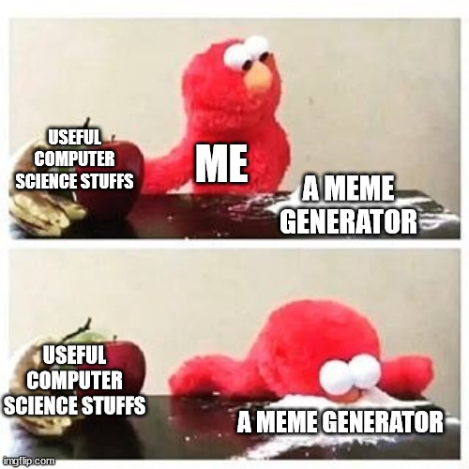

Illustration
Reaction

Slide 3
Why is this project relevant?
Lot of resources
Fun (I like memes)
Few technical difficulties

Slide 4

My concerns

Slide 5
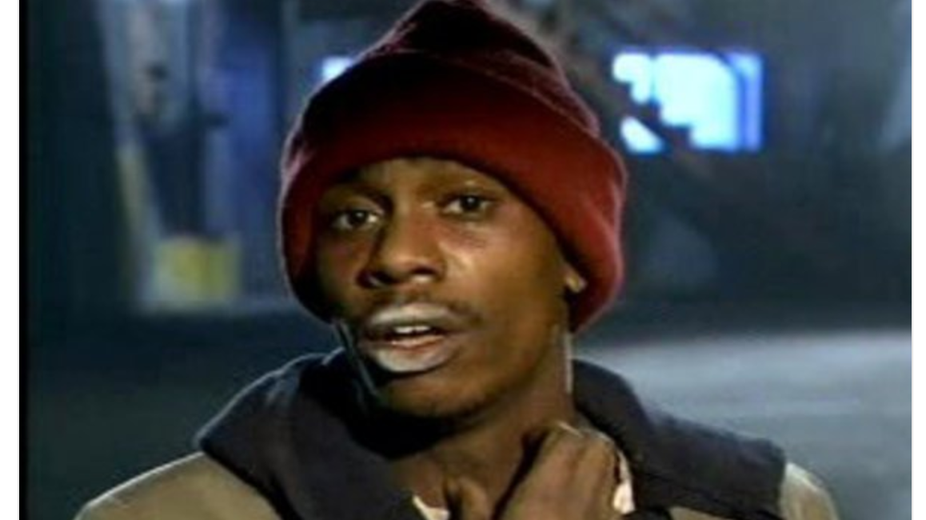
YALL GOT ANY QUESTIONS OR REMARKS?

